Slide 1
ASSET PRICE FORECASTING USING MACHINE LEARNING
Presented by
G.Vikram (18NR1A0534)
P.Vamsi Sai (18NR1A0557)
G.Jyothsna (18NR1A0534)
D.Yochana Rani (18NR1A0522)
Under the guidance by
Mr. S Durga Prasad
Associate professor
Department of CSE
BITS Vizag

Slide 2
Table of Contents
Abstract
Introduction
SRS
Analysis & design
Implementation
Conclusion
Future Enhancement

Slide 3
ABSTRACT
Every middle class person has a dream to construct a new house within their specified budget. They have to know particular information about a land or any house.
So there is a need for a system to predict land prices in the future and to know the projected price of an asset. This system helps in forecasting the price of property base on the previous data of the preferred location.
The goal of this project is to create a system to predict the price of a land or a any house. The system takes the various input from the user to predict the price of the land.
The prediction is done base on location, number of Square feets and Yards. This project can be very helpful for the real estate market.

Slide 4
INTRODUCTION
Nowadays Land price is drastically increasing as compared to earlier times. Most of the people have rough estimates regarding the land price etc.
There is no any predetermined method in calculating the cost of asset. We have to know about the future land pricing and in buying the land if the cost is not well predicted it may incur loss to the profit.
Manual predication of a land or price becomes more difficult, that’s why we proposed a system which is used to forecast the price of a land or a house.

Slide 5
EXISTING SYSTEM
Nowadays, Manual prediction of the price of a house or land is very hard. There are a lot of parameters that affect its price. Customers need to hire an agent to know the price of land or a house which again increases the cost of the process.
Drawbacks:
• It doesn’t predict the future prices of a house or land at a specific location mentioned by the
customer.
• Manual price prediction of an asset can lead to loss to the customers.

Slide 6
PROPOSED SYSTEM
In our system, we provide an interface for customers to complete their needs with ease. The customers can easily know the price of land or a house at the preferred location with our system. Prediction is done based on the past three year’s data of land or a housing dataset. we use the Linear Regression algorithm to forecast the price of land or a house.
Advantages:
• To eliminate the need of real estate agents to gain information regarding asset prices in the future

Slide 7
SOFTWARE REQUIREMENT SPECIFICATIONS
Purpose of this document
The Purpose of this SRS is to specify the requirements to create a web application for prediction of a land or house price. This software requirements provides a detailed overview of our software product, its parameters and goals. Nowadays Land price are drastically increasing as compared to earlier times. In this proposed project we designed a model to predict the price of a land or a house.
Scope
The main aim of this project is to forecast the price of a land or a house by machine learning techniques and to get the accurate price of a land or a house which reduce problems to the customers/buyers while buying a land or a house within their budget.

Slide 8
FUNCTIONAL REQUIREMENTS
Admin:
Add/delete location: Admin can add locations.
Add Density: Admin can add density of a land or a house by per unit area.
View Location: Admin can view the added locations.
Admin can only maintains the Datasets of the house or a land.
User:
Search/Select Location: User can select a specific location.
Select Density: User can specify the density of the land.
View Predicted Price: User can view the predicted price of land or a house.

Slide 9
NON-FUNCTIONAL REQUIREMENTS
Purpose Performance Requirements
In order to maintain optimal performance application, run on any system with at least following specifications:
-1.0 GHz Dual core processor
- At least 500 megabytes of storage.
- At least 4096 megabytes of RAM.
Windows OS: - 7 or above
Security:
The system’s security shall be ensured by admin, the administrator shall be able to login and modify/add the information of the various locations. General users shall not have access to modify content within the system however, under certain circumstances, users may give feedbacks to the system.

Slide 10
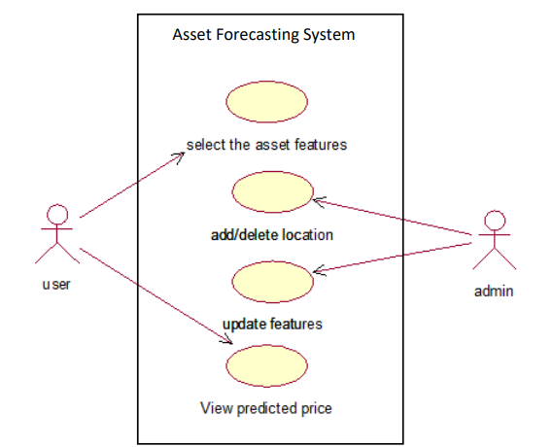
ANALYSIS DESIGN
UseCase Diagram
The main actors of this use case diagram are:- User and Admin, who perform the different types of use cases are search location, select area type , select total Sq. Ft, start prediction, view predicted price, add/delete locations, add area type, change plot values, modify the price, and maintain dataset.

Slide 11
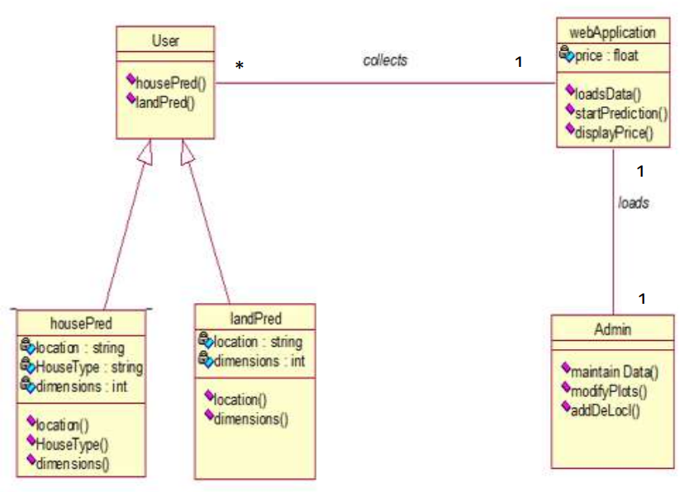
Class Diagram
User will be knowing the predicted value from the web application.
Web application contains the data of land and house.
House location, type, dimensions are dimensions are provided.
Admin will maintain the dataset and modify the data

Slide 12
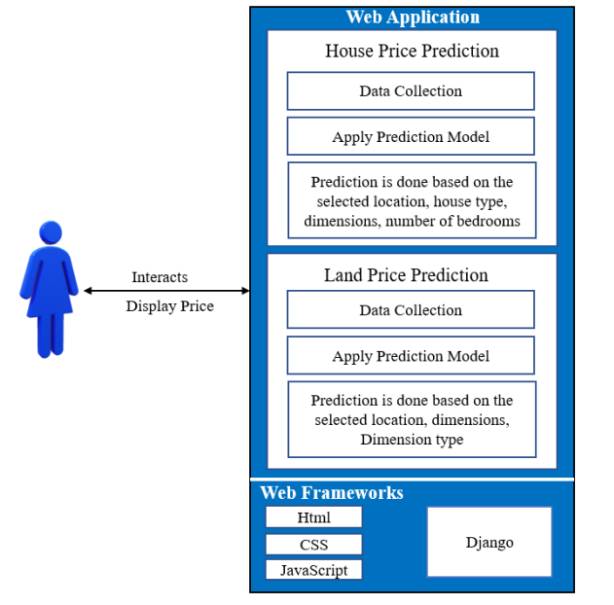
Architecture Diagram
An architectural diagram is a visual representation that maps out the physical implementation of components of a software system. It shows the general structure of the software system and the associations, limitations, and boundaries between each element. An architecture diagram is a visual representation of all the elements that make up part, or all, of a system. Above all, it helps the engineers, designers, stakeholders and anyone else involved in the project understand a system or app’s layout. There are many kinds of architecture diagrams, like a software architecture diagram, system architecture diagram, application architecture diagram, security architecture diagram, etc.

Slide 13
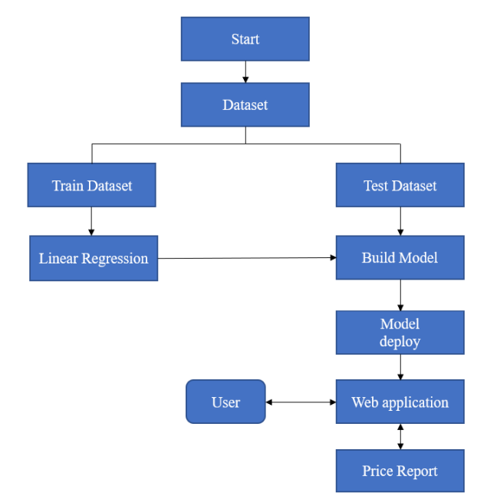
Project Flow

Slide 14
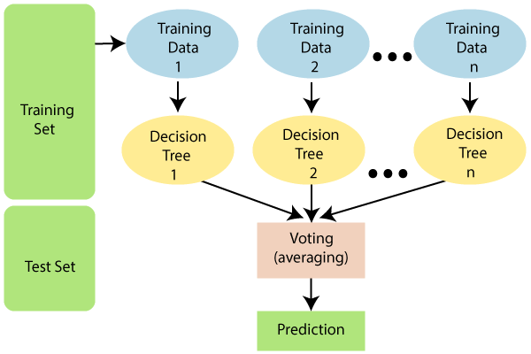
Random Forest Algorithm
Random Forest is a popular machine learning algorithm that belongs to the supervised learning technique. It can be used for both Classification and Regression problems in ML.
Random Forest is a classifier that contains a number of decision trees on various subsets of the given dataset and takes the average to improve the predictive accuracy of that dataset.
The greater number of trees in the forest leads to higher accuracy and prevents the problem of overfitting.

Slide 15
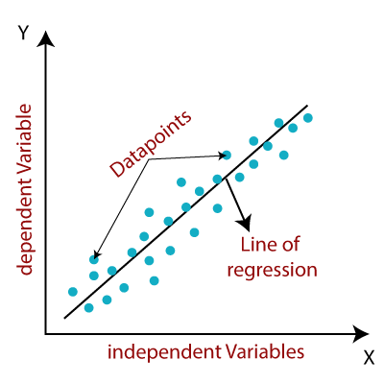
Linear Regression Algorithm
Linear regression algorithm shows a linear relationship between a dependent (y) and one or more independent (y) variables, hence called as linear regression.
Since linear regression shows the linear relationship, which means it finds how the value of the dependent variable is changing according to the value of the independent variable.

Slide 16

Decision Tree Algorithm
Decision Tree is a Supervised learning technique that can be used for both classification and Regression problems, but mostly it is preferred for solving Classification problems.
The decisions or the test are performed on the basis of features of the given dataset.
It is called a decision tree because, similar to a tree, it starts with the root node, which expands on further branches and constructs a tree-like structure.

Slide 17
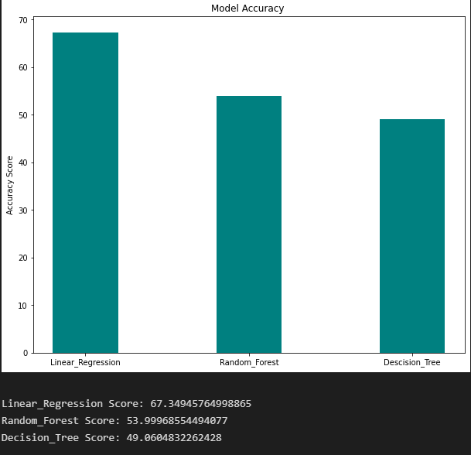
Screenshots

Slide 18
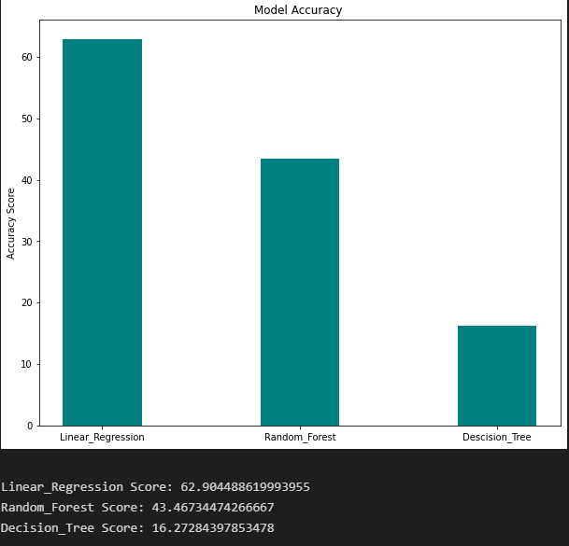

Slide 19
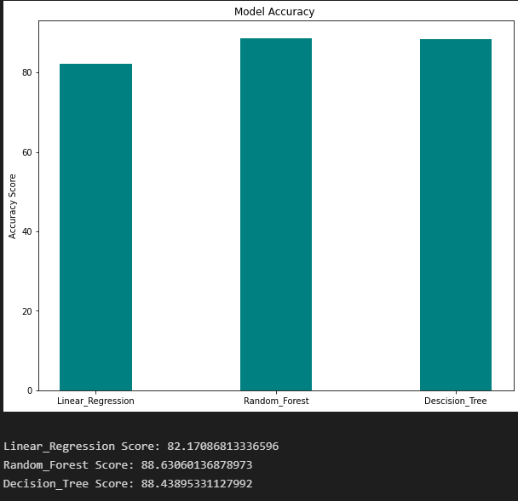

Slide 20
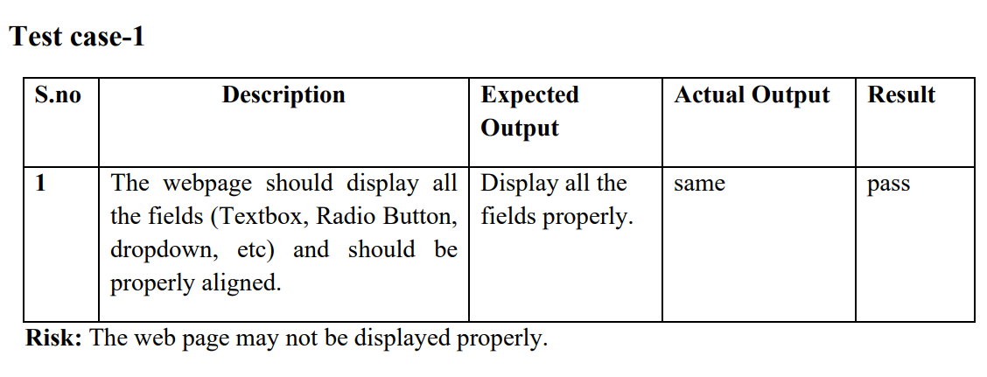
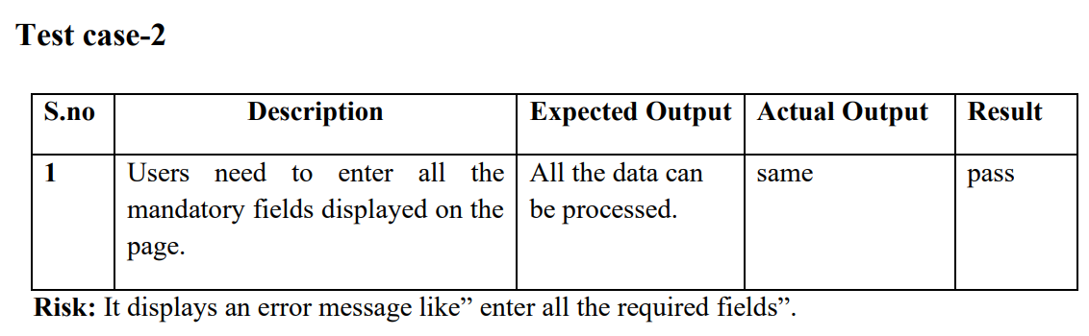
Testing Cases

Slide 21
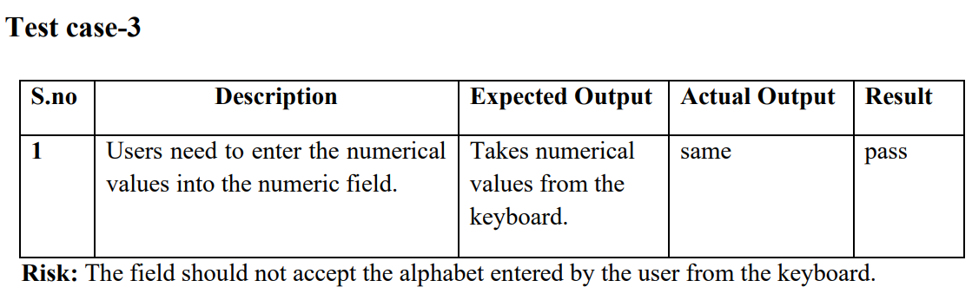
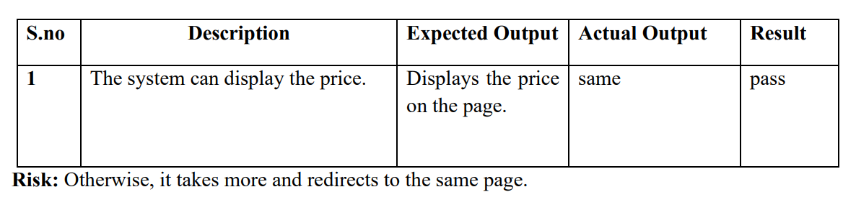
Test case-4

Slide 22
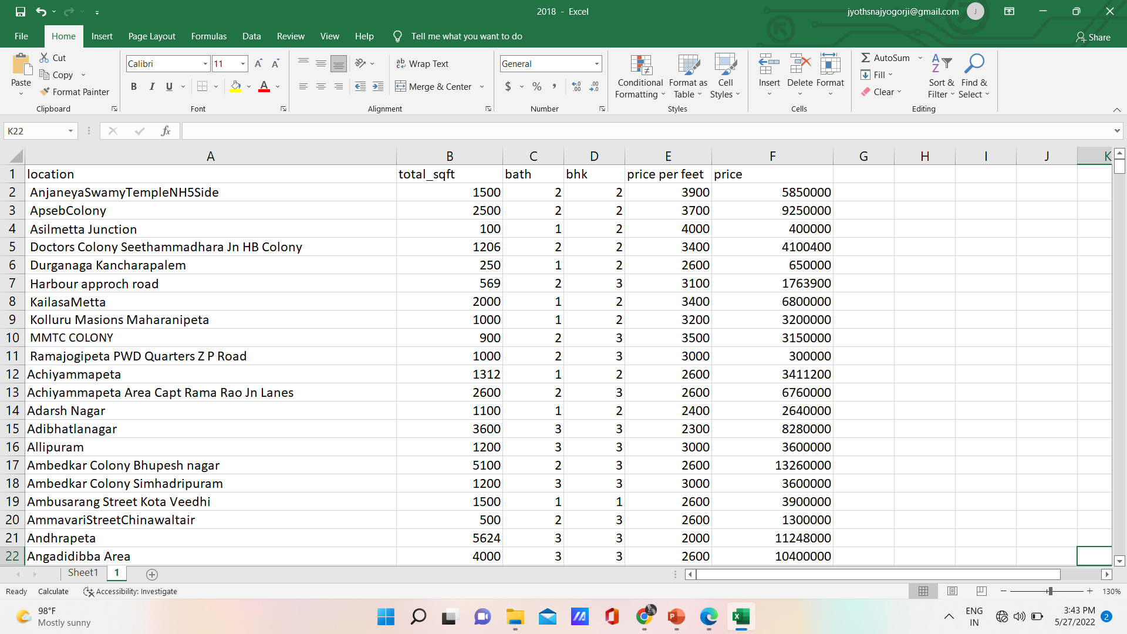
Data Set

Slide 23
Conclusion
The project “Asset Price Prediction Using Machine Learning” has been developed to predict house and land prices based on various features on the dataset. In this project, the website allows the user to know the price of the asset.
We use the Linear Regression Algorithm to predict the asset price according to the customer requirement with an average of 75% accuracy. The main objective is to achieve a system that will reduce the human effort to calculate the price of a house or land in future years

Slide 24
Future Enhancement
There are some improvements and additions which can be done. The first is the ability to increase and update the dataset on a regular basis and to add a budget recommendation model to the system, enabling users to know the price of the asset within their budget. So it becomes different from other prediction system. It helps people to know the price of the asset in the future

